Slide 1

The Gilda Stories

Slide 2

Octavia Butler, Fledgling

Slide 3


Slide 4
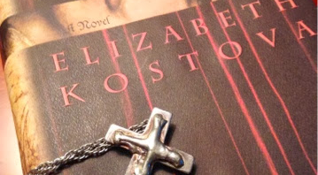

Slide 5


Slide 6


Slide 7
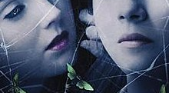
The Moth Diaries, Rachel Klein

Slide 8
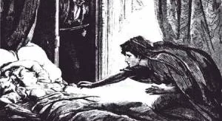
Carmilla, Le Fanu

Slide 9


Slide 10

Ana Lily Amirpour, 2014

Slide 11

Karl Heinrich Ulrichs

Slide 12


Slide 13


Slide 14
